Slide 1

They Just Won’t Do it:
Getting Neurodivergent Kids “Unstuck”
Matthew J. Zakreski, PsyD

Slide 2
Who am I?
Dr. Matt Zakreski – you can call me ”Dr. Matt”
I’m a clinical psychologist, professional speaker, and neurodivergence advocate
I’m known as someone who can bridge neuroscience and clinical practice to make skills accessible for you and your loved ones

Slide 3
Goals for Today
Understanding why students get stuck
01
Understanding how to engage with students who are stuck
02
Understanding how to organize your classroom/workload to help keep kids from getting unstuck
03

Slide 4


Slide 5
If it was easy, your kids would have done it already.
#drmatt

Slide 6

Kids Get Stuck
I can’t do it!
I won’t do it!
I don’t know how to do it!
“School sucks!”
“This is boring!!”
“Can I just go play Minecraft?”

Slide 7
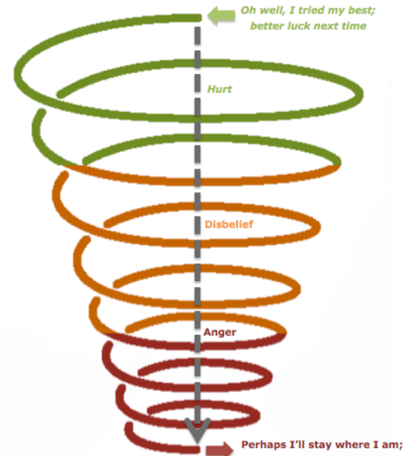
What is getting stuck?
An anxious response to something new or difficult (Fight, Flight, or FREEZE)
The physiological response is very unpleasant
  I’m not working
  I’m upset that I’m not working
  OMG I’m falling behind
  Now I’m panicking
  That anxiety is making it even harder to work
  Repeat
Environmental Response
  Student?
  Teacher?

Slide 8
Why gifted kids?
Emotional intensity
Heightened emotional response system (limbic system integration)
Difficulties in seeing context
Asynchronous development
  High potential for mismatch
Big ideas / elaborate plans - “Theory of Relativity Syndrome”

Slide 9
Case Example:
Bryce
10-year-old student
IQ: 132. Diagnoses: ADHD, Sensory Processing Disorder, Dyslexia
Attends a school for gifted/2e kids
Standing in the hallway bouncing back and forth between the walls
When does this happen? What’s the common denominator?

Slide 10


The C.R.O.W.B.A.R. Technique

Slide 11
Best. Acronym. Ever.
C - Context
R – Rationality
O – Out of Control
W – Work Differentiation
B - Behavior
A - Alternatives
R - Relationships

Slide 12
C - Context
We are very context-dependent people – but we don’t think of ourselves that way
Can improve our behavior
Can weaken our performance
Can shift our focus
School presents thousands of different contexts throughout the day (often with variables that we don’t see/understand)
Developmentally, adults are better equipped to see the broader, long-term contexts – we need to help our kids see it

Slide 13
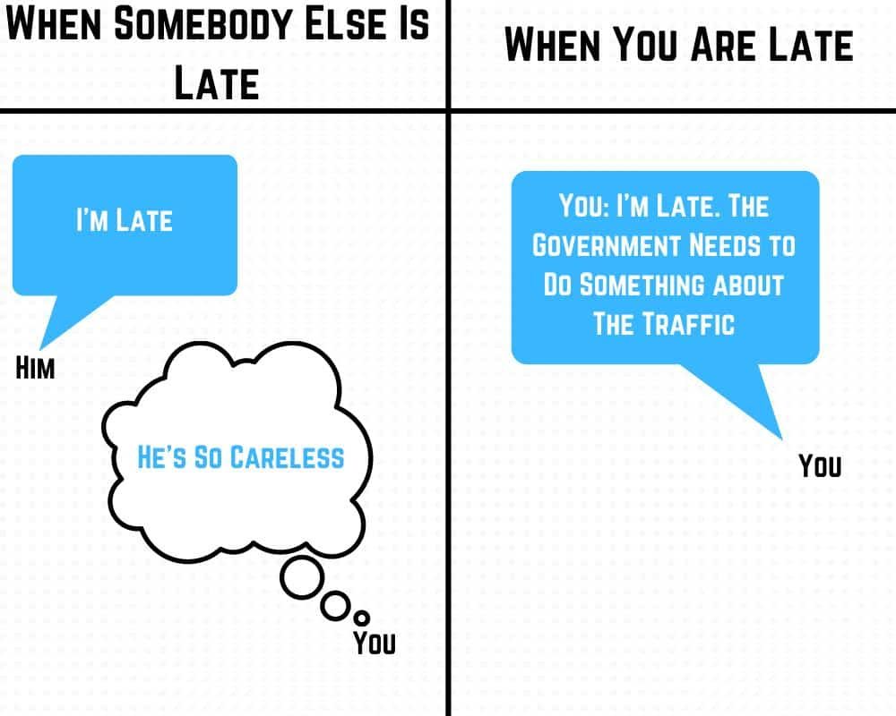
Fundamental Attribution Error (FAE)
The fundamental attribution error refers to an individual's tendency to attribute another's actions to their character or personality, while attributing their behavior to external situational factors outside of their control.
  Who here has ever procrastinated on a big project?
  Who here has ever had an excuse for that procrastination?
Context has a huge impact on our behavior!

Slide 14
R – Rationality
We often expect gifted/neurodiverse kids to be more rational than they actually are
Asynchronous development
How do kids look when they are stuck?
Would anyone CHOOSE to feel that way?
We tend to respond initially with rational arguments – is that really the issue?
Content vs. Process

Slide 15
What anxiety looks like in kids
Anger (especially at little things)
Difficulty sleeping (at home) or settling (in class)
Defiance
Explosions (may “come out of nowhere”)
Lack of focus
Overplanning
Avoidance – finding reasons not to
Negativity “I can’t so I won’t”
Focus on the future
Procrastination

Slide 16
O – Out of Control
Kids are very sensitive to their environments and changes to them
  May not be able to articulate those feelings
People control what they can control, when they can control
Kids have relatively little control in their lives – so where do they express their control?
Arguing is a way of control – predictable vs. unknown

Slide 17

Arguing!
Who wants to argue with me?

Slide 18
W – Work, Differentiated
Differentiated Instruction (Carol Tomlinson) is the gold standard of how to adapt classrooms to the educational needs of gifted and 2E learners
DI is a student-centered, interest-driven approach to adapting curricula (we teach the students we HAVE, not the students we WANT to have)
In DI, the teacher anticipates the differences in students' readiness, interests, and learning profiles
DI creates different learning paths so that students can learn as much as they can as deeply as they can, without
undue anxiety because the assignments are too taxing
boredom because they are not challenging enough.

Slide 19
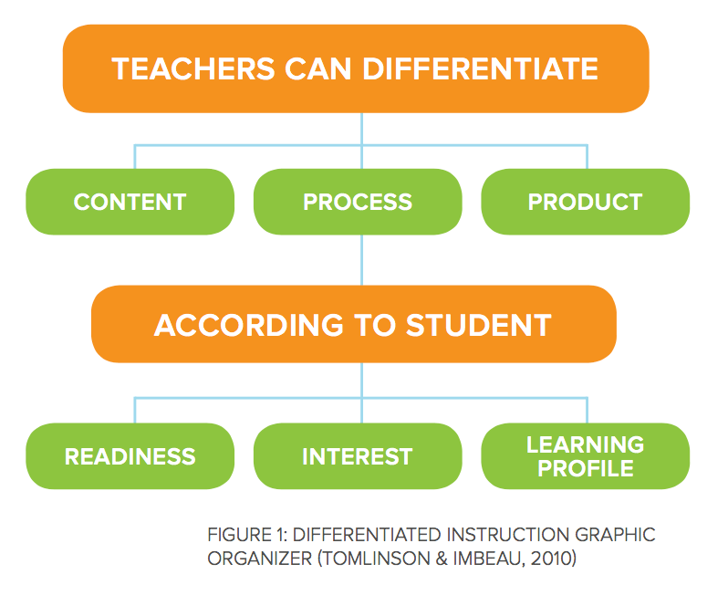

Slide 20
Creating Flow
Mihaly Csikszentmihalyi
A highly focused mental state that is conducive to productivity (“in the zone”)
  Runners high
  What do you like doing?
  Time goes away
Seeking intrinsic motivation – we are doing this because we want to and because we are enjoying it
Challenge and skill level must match
Flow undoes getting stuck

Slide 21
B - Behavior
Quick behavioral primer
Reinforcement – we want a behavior to increase in frequency
Punishment – we want a behavior to decrease in frequency
Positive – we are adding something to the situation
Negative – we are taking something away from the situation
Praise the behaviors that we want to see
Try to ignore and/or redirect the behaviors we don’t want to see

Slide 22
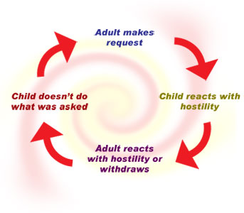
The Coercive Cycle

Slide 23

Consequences over Punishment
Punishment doesn’t work! (At least not how we think it does)
  We get frustrated
  Punishment is about US (Consequences are about the kids)
Natural consequences –
  work at home
  Potentially failing a test
Speed trap

Slide 24
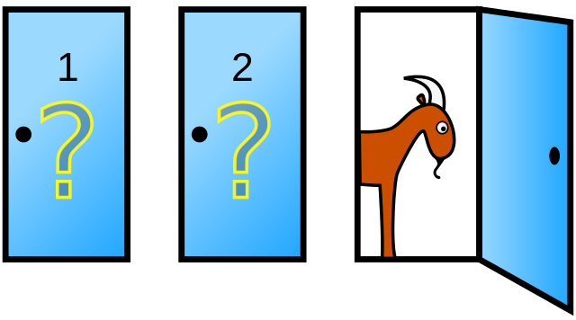
A - Alternatives
Getting stuck has its roots in ANXIETY – fight or flight responses in students and us
Third Door – not just dig in or give in.
Step out of the conflict cycle
Remember, we are playing the long game – whatever gets done is a step in the right direction
What else can we do?
  Bored/Break Box
  Move your body
  Do support work

Slide 25
Phrases to Use When You Hear “I Can’t!!!!”
Instead of | Use
“Yes, You Can!!!” | “This is definitely hard to do. You’ve done a lot of hard things in the past, too. And this is really hard right now.”
“Ask [adult] to help you.” | ”Do you want to keep trying or ask for help?”
“Move over, I’ll do it.” | “What resources do you have available to help you do this?”
“Positive vibes only!!!” | “This looks like it’s frustrating you. Let’s take a break together.”

Slide 26

R - Relationships
All students do better when they feel like they are seen, understood, liked, and valued
Teaching/therapy/coaching is an inherently personal act
The relationship is like a bank account – you can make a withdrawal, but you need ”money”
You can get a kid to move without a relationship, but they hold the key – what happens if you try to open a door without a key?

Slide 27


Slide 28
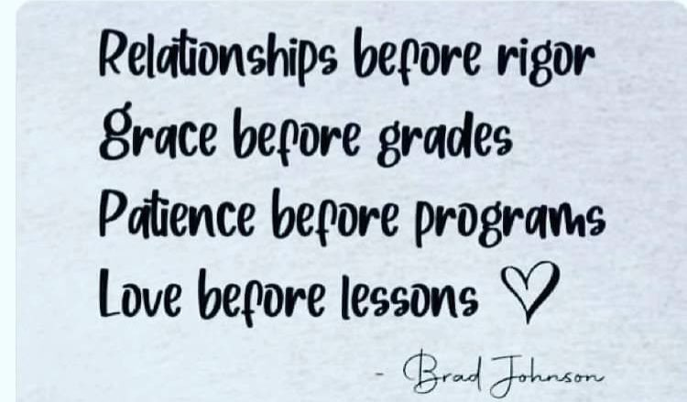

Slide 29
It’s Not Just the Kids! Ways Adults keep our kids struggling
1. Being helicopter parents. (Or teachers)
2. Adopting the "everyone gets a trophy" mentality.
7. Not letting them fail.
3. Turning them into praise hounds.
4. Not giving them chores.
5. Over-programming them.
6. Being a friend and not a parent. (Or teacher)

Slide 30
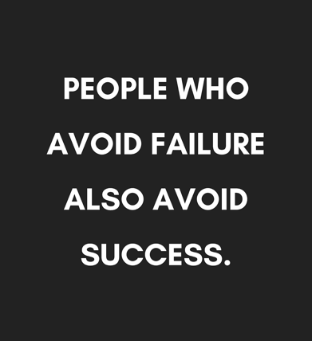
What is getting stuck all about?
Avoiding failure (and the pain associated with it) however you possibly can.
  and when you’re a neurodivergent kid, you have many ways to avoid pain
  And you’re probably way too experienced at failure
We need to NORMALIZE
  Struggling
  Trying and failing
  Learning from our mistakes (F.A.I.L.)

Slide 31

Let’s Play a Game!

Slide 32
Techniques to use
Five-minute doodles – just keep your pen/pencil on the page for 5 min, moving as much/little as you want
Two-minute mountain – the first two minutes are the hardest; if you can get grit your teeth and get through them, everything else gets easier
“Now you can’t” challenge – you wanted to do your project this way, imagine that now you can’t, what would you do instead
Reverse engineer – imagine you did it and you’re done! Explain to me how you did it

Slide 33
Questions to ask
What does this student know about this topic before we get started?
How does this student like to learn?
What gets this student stuck?
How does this student like to show what they know?
What holds this student’s interest?
How well do they work independently? In groups? At home?

Slide 34
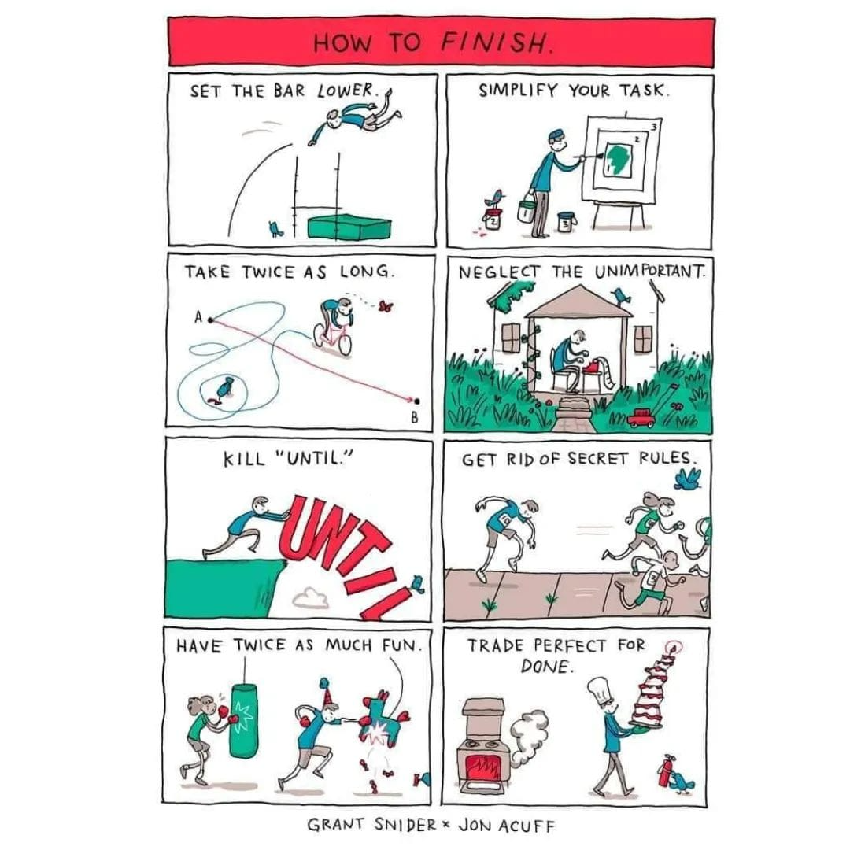

Slide 35
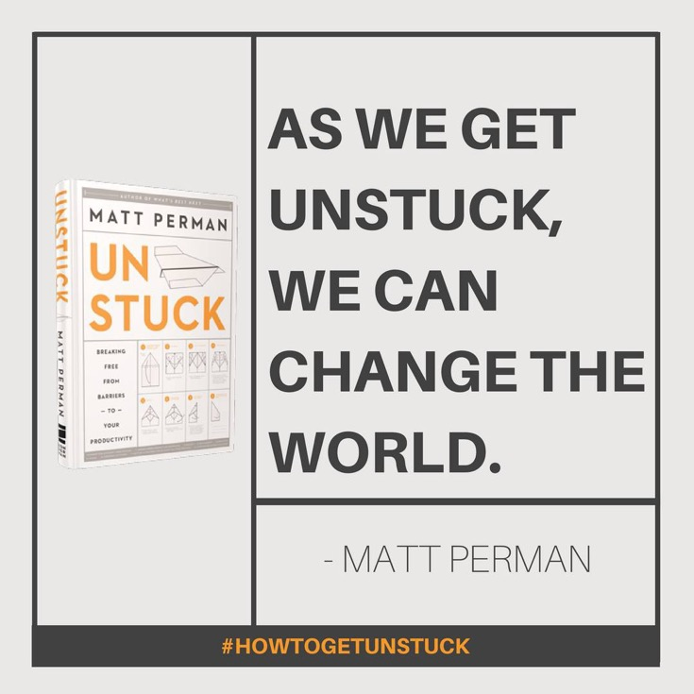
What happened to Bryce?

Slide 36
Takeaways
Relationships matter - with your students, parents, administrators, coaches, etc.
Context matters – pay attention to what is going on (and ask about what you don’t know)
Step out of the coercive cycle when you can
Kids don’t choose to get stuck – anxiety gets them stuck
Be curious when you can
Differentiated instruction can provide the pedagogy to stay on curriculum
Take the long view
If it was easy…

Slide 37



More resources
https://blog.brookespublishing.com/how-to-get-students-unstuck-on-target-an-executive-function-qa/
http://www2.edc.org/makingmath/handbook/teacher/StuckAndUnstuck/StuckAndUnstuck.asp
https://www.edutopia.org/article/writing-getting-students-unstuck
https://www.pinterest.com.mx/pin/141441244537207163/
https://biglifejournal.com/blogs/blog/struggle-is-important
https://logicaloperations.com/insights/blog/829/unstuck-your-virtual-student/ (For virtual learners!)
https://www.jmring.com/how-to-get-unstuck/
https://pdo.ascd.org/LMSCourses/PD11OC115M/media/DI-Intro_M1_Reading_What_Is_DI.pdf

Slide 38
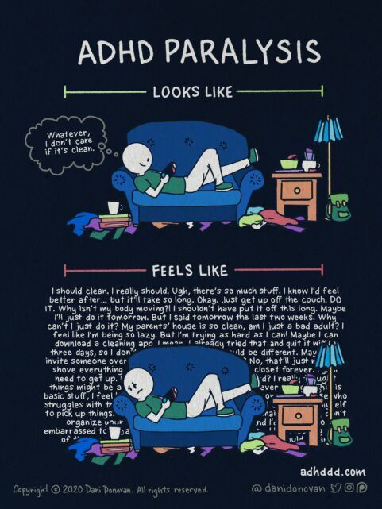
Questions?
Feel free to reach out to me with more questions at:
drmatt@theneurodiversitycollective.com
www.Facebook.com/drmattzakreski
www.Drmattzakreski.com

Slide 39
References
Albert, R. S.; Runco, M. A. (1999). "A History of Research on Creativity". In Sternberg, R. J. (ed.). Handbook of Creativity. Cambridge University Press.
Averill, James R. (February 1999). "Individual Differences in Emotional Creativity: Structure and Correlates". Journal of Personality. 67 (2): 331–371
Chai, H., & Altchuler, S. (2020). “Getting unstuck”: An exploration of the reluctant readers and the impact of visualization strategies. Reading Improvement, 56(4), 197-207.
Csikszentmihalyi, Mihaly (1996). Creativity : Flow and the Psychology of Discovery and Invention. New York: Harper Perennial.
Helie S.; Sun R. (2010). "Incubation, insight, and creative problem solving: A unified theory and a connectionist model". Psychological Review. 117 (3): 994–1024
.Kaufman, J. and Beghetto, R. A. (2009). "Beyond Big and Little: The Four C Model of Creativity". Review of General Psychology. 13 (1): 1–12.
King, J. (2018). Getting Unstuck: Using the Conceptual Mapping Task as a Dynamic Supervision Tool for Trainees and Seasoned Counselors.
McCartney, R., Eckerdal, A., Mostrom, J. E., Sanders, K., & Zander, C. (2007, June). Successful students' strategies for getting unstuck. In Proceedings of the 12th annual SIGCSE conference on Innovation and technology in computer science education (pp. 156-160).
Mumford, M. D. (2003). "Where have we been, where are we going? Taking stock in creativity research". Creativity Research Journal. 15 (2–3): 107–120.
Naglieri, J. A.; Kaufman, J. C. (2001). "Understanding intelligence, giftedness, and creativity using PASS theory". Roeper Review. 23 (3): 151–156
Renzulli, J. S. (1978). "What makes giftedness? Reexamining a definition". Phi Delta Kappan. 60: 180–261.
Smith, S. M. (2011). "Incubation". In M. A. Runco; S. R. Pritzker (eds.). Encyclopedia of Creativity Volume I (2nd ed.). Academic Press. pp. 653–657
Trnka, R.; Zahradnik, M. and Kuška, M. (2016). Emotional creativity in real-life activities. Creativity Research Journal. 28 (3): 348–356

